Slide 1
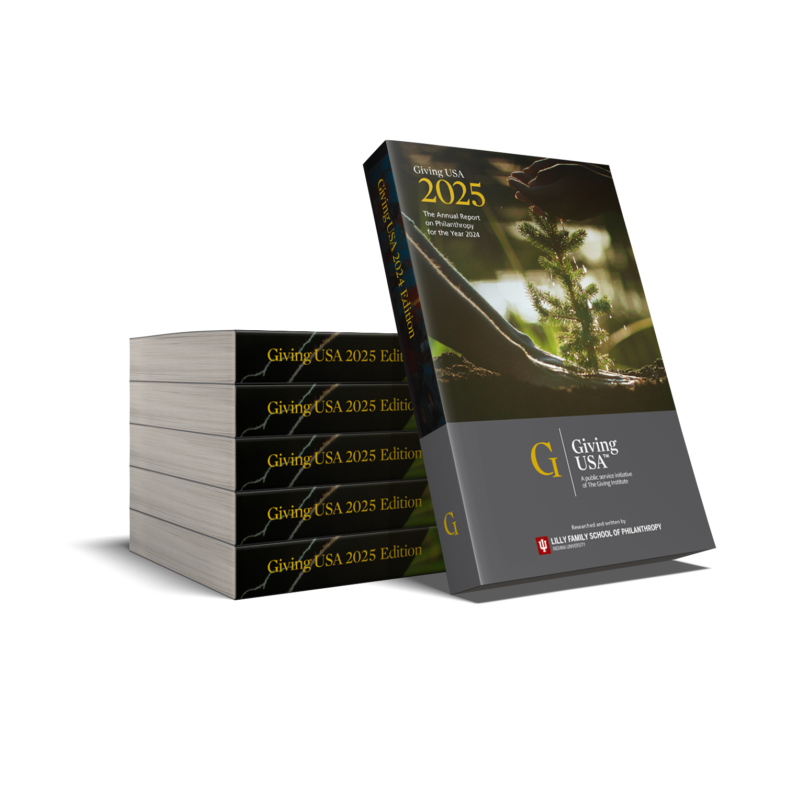


Perspectives
on Philanthropy,
Giving USA
JUNE 24, 2025

Slide 2
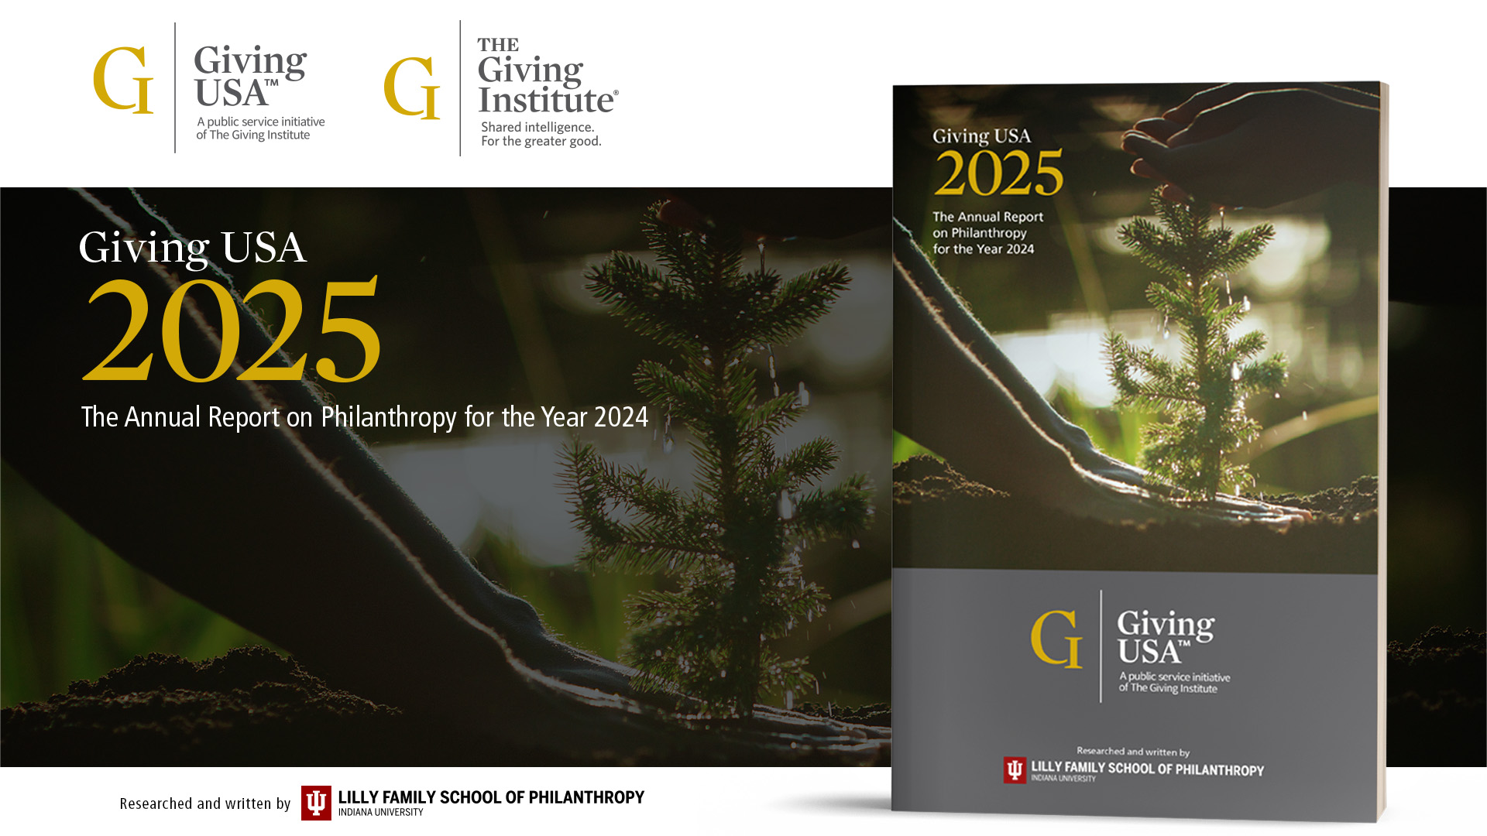

Slide 3
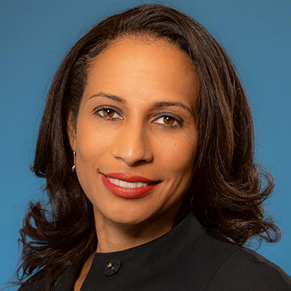
Introduction of the Report
Dr. Una Osili
Efroymson Chair in Philanthropy, Professor of Economics and Philanthropic Studies, and Associate Dean for Research and International Programs
Indiana University Lilly Family School of Philanthropy

Slide 4
THE BIG PICTURE

Slide 5
1. Charitable giving totaled $592.50 billion in 2024
Giving reached a high in current dollars
When adjusted for inflation, 2021 remains the best year of giving on record

Slide 6
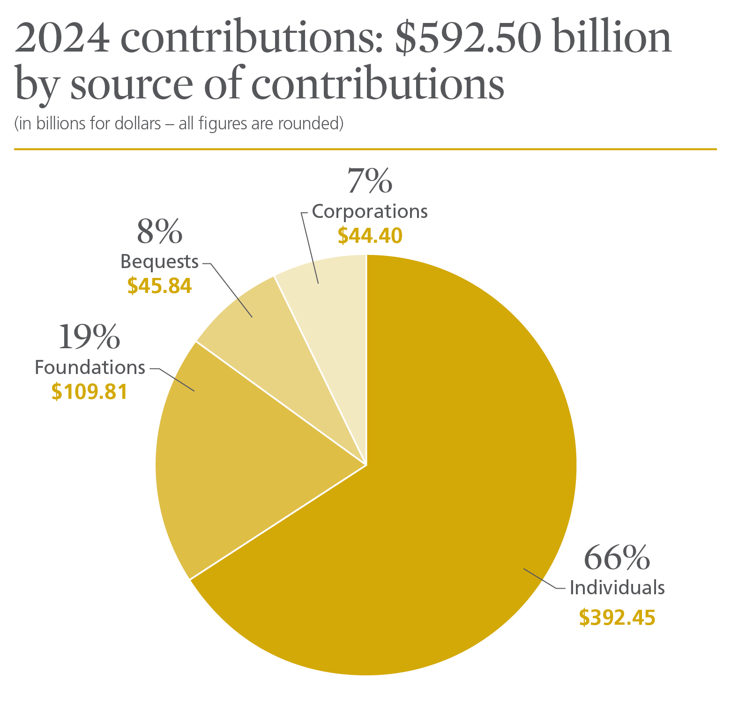
Notes:
Giving by individuals comprised 66 percent of total giving in 2024.¹
Giving by foundations—which includes grants made by independent, community, and operating foundations—amounted to 19 percent of all gifts made in 2024.²
Giving by bequest accounted for 8 percent of all gifts made in 2024.
Giving by corporations comprised 7 percent of total giving in 2024.

Slide 7
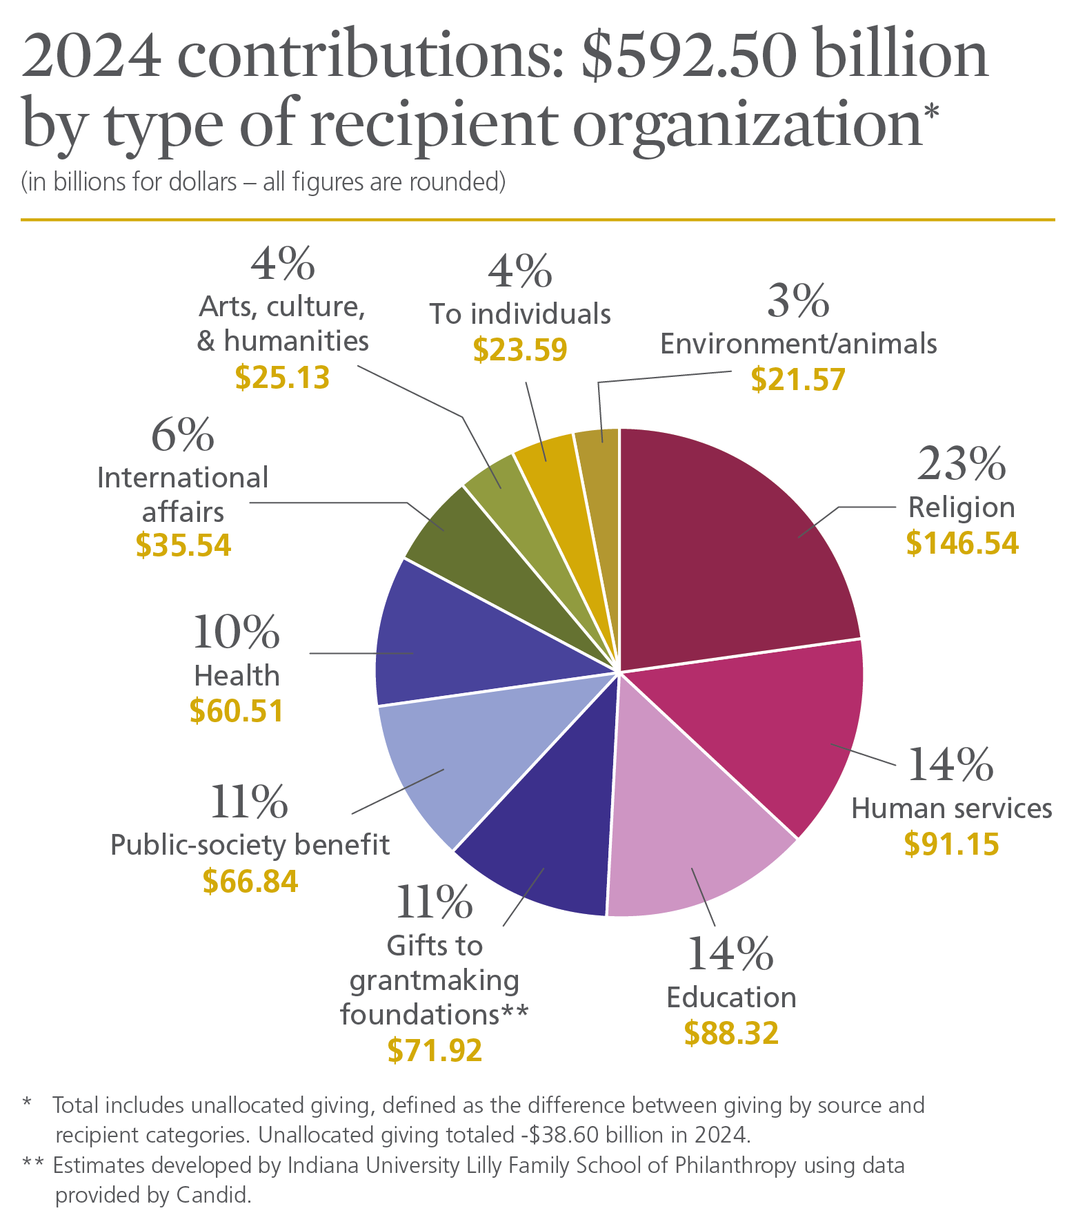
Notes:
Religious organizations received the largest share of charitable dollars in 2024, at 23 percent of total giving.³
Human services organizations comprised the second-largest portion in total gifts received, at 14 percent of the total in 2024.
The education subsector ranked third in total gifts received, at 14 percent of charitable dollars in 2024.
Gifts to grantmaking foundations—including independent, community, and operating foundations—comprised the fourth-largest share of charitable dollars in 2024, amounting to 11 percent of total giving.
The public-society benefit organizations subsector ranked fifth in total gifts received, at 11 percent of charitable dollars in 2024.
Comprising the sixth-largest portion of charitable dollars in 2024, the health subsector received 10 percent of total giving.
The international affairs subsector ranked seventh in total gifts received, amounting to 6 percent of charitable dollars in 2024.
Arts, culture, and humanities organizations received the eighth-largest portion of charitable dollars in 2024, at 4 percent of total giving.
Comprising the ninth-largest share of charitable dollars in 2024, the environment and animals subsector received 3 percent of total gifts.
Additionally, gifts made directly to individuals amounted to 4 percent of total giving in 2024.

Slide 8
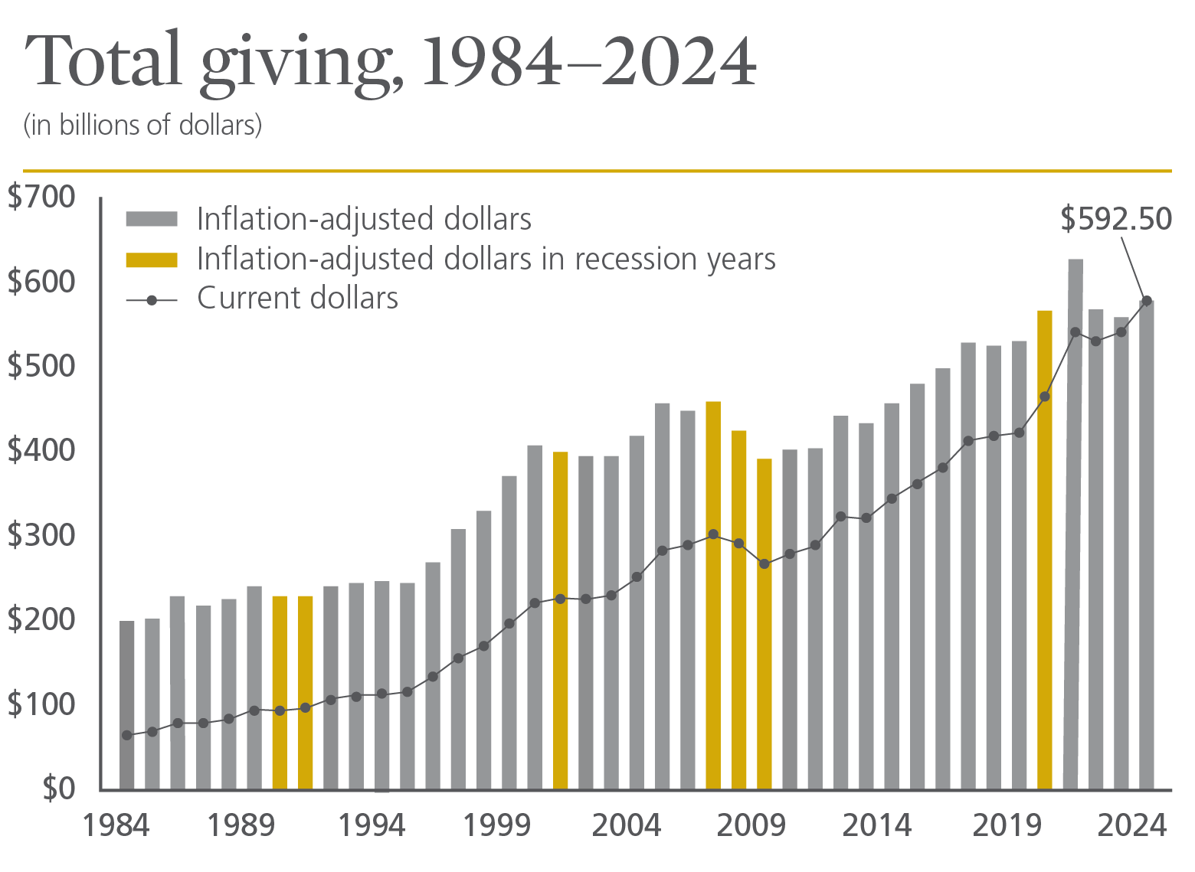
Notes:
Total giving reached $592.50 billion in 2024, a 6.3 percent increase in current dollars. In inflation-adjusted terms, total giving increased by 3.3 percent in 2024.¹⁰
Total charitable giving has increased or stayed flat in current dollars every year since 1984, with the exception of four years that saw declines: 1987, 2008, 2009, and 2022.¹¹ The annualized average rate of change in total giving in current dollars since 1984 is 5.5 percent. By comparison, the rate of change between 2023 and 2024 is fairly similar to the 40-year annualized average.
Adjusted for inflation, total charitable giving has declined eleven times since 1984, most recently in 2023.¹² The average annualized rate of change in total giving in inflation-adjusted dollars since 1984 is 2.7 percent, similar to the inflation-adjusted rate of change between 2023 and 2024.
The Great Recession ended in 2009. For the most recent decade from 2015 to 2024, the total growth in inflation-adjusted giving is 20.0 percent.
In 2024, only corporations reached an all-time high in inflation-adjusted terms, while foundations reached the second highest levels of giving on record. On the recipient side of giving, four charitable subsectors exceeded previous highs in inflation-adjusted terms.

Slide 9
1. Charitable giving totaled $592.50 billion in 2024
Total giving lifted by individual and corporate giving
Three of four sources grew in current dollars
Strong market performance, a solid economy, and stabilizing inflation contributed to overall growth

Slide 10
UNDERSTANDING THE GIVING ENVIRONMENT

Slide 11
2. Total giving growth in 2024 reflects long-run average
Total giving grew at rates similar to 40-year average growth of giving
The financial markets had a strong year while most other economic indicators grew at a healthy 2-3% rate after adjusting for inflation
A solid economy on stable footing likely contributed to the growth in giving
Financial security linked to giving

Slide 12
3. Individuals remain large majority of giving
Giving by individuals was 66% of overall giving in 2024
  This is a decrease from ten years ago, but still a sizable majority
Corporate giving has pushed up to 7% of total giving, as high as it has ever been in the past 40 years
  Corporate giving is still the smallest share of our tracked sources

Slide 13
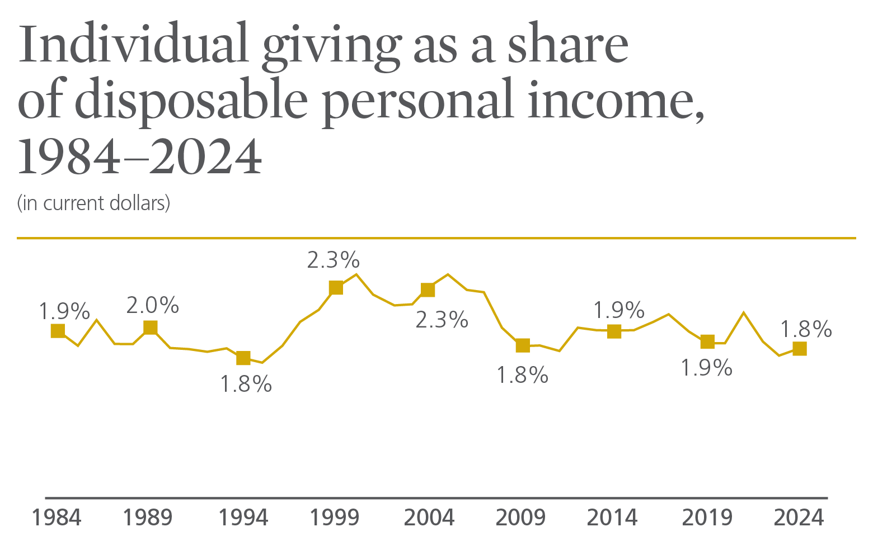
Notes:
Disposable personal income is tied to total household income, which is a key determinant of how much households give. In many cases, how much households give depends on their spendable, or disposable personal, income. This type of income is defined as that which is available after taxes have been paid.²⁸
In 2024, disposable personal income increased by 5.3 percent in current dollars from 2023. Adjusted for inflation, disposable personal income increased by 2.2 percent. This compares with an 8.2 percent increase in individual giving between 2023 and 2024, or 5.1 percent increase when adjusted for inflation.²⁹
Individual giving as a percentage of disposable personal income was 1.8 percent in 2024—remaining steady compared with 2023, when individual giving also represented 1.8 percent of disposable personal income.
During the last 40 years, individual giving as a percentage of disposable personal income reached its highest level in 2005, at 2.4 percent. Individual giving as a percentage of disposable personal income reached its lowest levels in 1995, dropping to 1.7 percent.

Slide 14
4. Individual giving grew amid strong economy
Giving by individuals grew 8.2% in current dollars (5.1% adjusted for inflation)
Inflation, while still at around 3%, was lower than in previous years
Consumer sentiment was up strongly from 2023, but still low historically
Mega giving was $11.72 billion this year, comparable to other recent years

Slide 15
5. Giving by foundations reached a current dollar high and
exceeded $100 billion for the third consecutive year
Strong market performance in recent years has elevated foundation giving
Last three years have seen large and steady foundation giving

Slide 16
6. Strong GDP and profits helped corporations record a
record high
Corporate giving continues to show the strongest recent-term growth; the five- and ten-year annualized growth rates for corporate giving are the highest among all sources
Giving by corporations remains the smallest portion of total giving at 7%, though it saw the highest growth this year at 9.1% (6.0% when adjusted for inflation)
Giving by corporations held steady at 1.1% of pre-tax profits

Slide 17
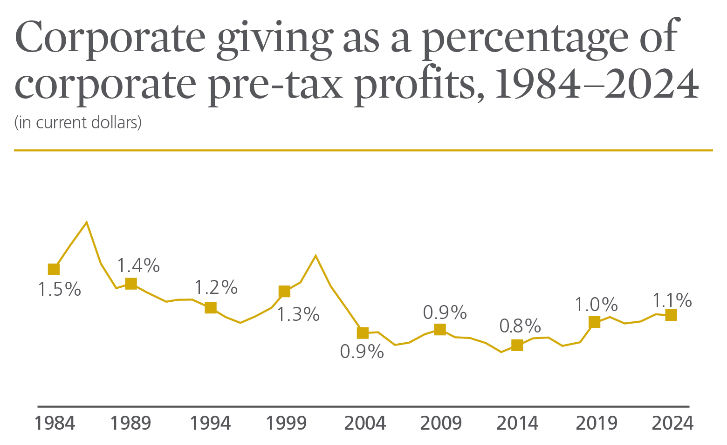
Notes:
Corporate pre-tax profits are a significant factor in how much corporations give each year, and changes in corporate giving closely follow corporate pre-tax profits.
Giving by corporations, which includes grants from corporate foundations, is estimated to be 1.1 percent of corporate pre-tax profits for 2024.³⁰
Corporate giving as a percentage of corporate pre-tax profits was at its highest point in the mid-1980s, when it reached 2.0 percent in 1986.
In the last four decades, since 1984, corporate giving as a percentage of corporate pre-tax profits has averaged 1.1 percent.

Slide 18
7. Subsectors receiving the largest dollar amounts are
shifting over time
Giving to foundations accounts for a considerably larger share than 40 years ago
Giving to individuals – which mostly represents in-kind donations of pharmaceuticals directly to patients – has grown quickly and been larger than Environment/Animals in recent years

Slide 19
8. Subsectors that grew the most in 2024 recovered from
2023 declines
Giving to education, health, arts, and environment/animals reached record highs, even when adjusted for inflation
Giving to public-society benefit, international, and education all experienced double-digit growth in current dollars
  Each of these had weaker years in 2023

Slide 20
9. Seven of the nine recipient categories grew, even after
adjusting for inflation
All sectors saw growth in current dollars
Increases across a multitude of causes show a healthy sector

Slide 21
10. Online giving accounts for a growing share of giving
Charitable Giving Report: Using 2020 Data to Transform Your Strategy, Blackbaud Institute, 2021

Slide 22
Thank you.

Slide 23
Panel Discussion

Slide 24
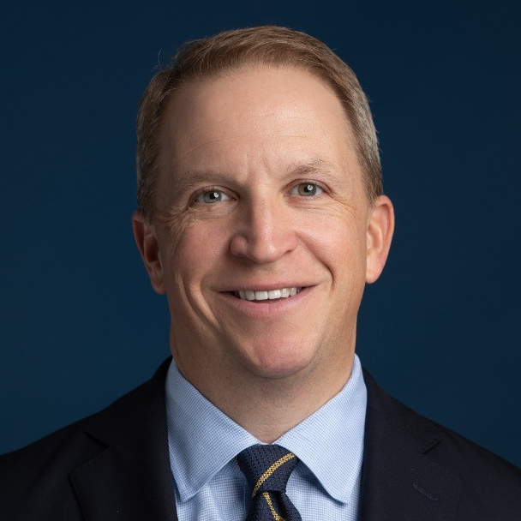
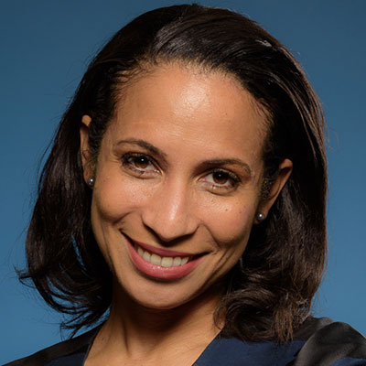
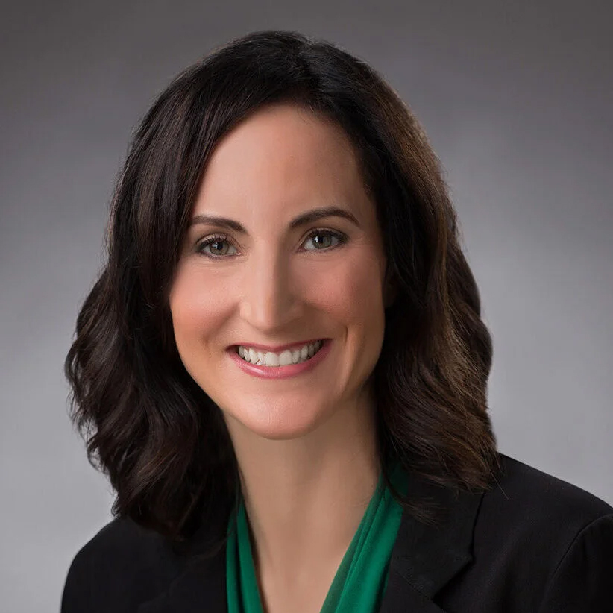
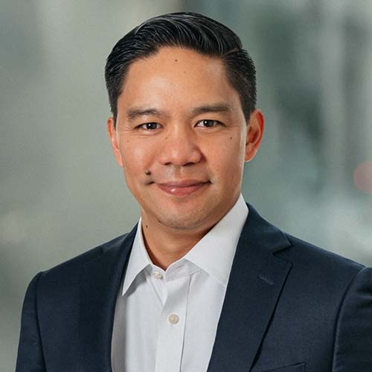

TODAY’S SPEAKERS
Tim McMahon
Dr. Una Osili
Emily Church
Vice President, University Advancement
Marquette University
Associate Dean for Research
IU Lilly Family School of Philanthropy
Chief Impact Officer
Meadows Mental Health Policy Institute
Eric Javier
Polly Breit
Principal & Managing Director
CCS Fundraising
EVP, Client Services
CCS Fundraising

